Slide 1

2023 INTERNSHIP PROJECT
REPORTING CYCLE: March – April 2023
PRESENTED BY: Group 1

Slide 2
TEAM MEMBERS
Group 1
Michelle Kwarteng (Ass Team Lead)
Tajudeen Yusuf Alabi (Member)
Daniel Okechukwu Nwaogwugwu (Member)
Rotimi Olatunde Fawumi ( Team Lead)

Slide 3
SECTIONS
ANALYSIS TOOLS
KEY PERFORMANCE INDICATOR
BENCHMARK
TEAM MEMBERS
OVERVIEW
TERMINOLOGY
ANALYSIS
GAP ANALYSIS OVERVIEW
RECOMMENDATION
CONCLUSION
PROBLEM STATEMENT

Slide 4
DATA COLLECTION AND ANALYTICAL TOOLS
ONE DRIVE
1. MICROSOFT EXCEL
SLACK
Webinarjam CRM

Slide 5
Terminology
Webinar is an interactive online event where a group of participants can listen to a speaker who delivers a presentation.
Automated event are webinars that are on autopilot.
Live streaming is an in-person event
Registrants are persons who have completed the sign-up process to attend the event.
Attendees are a persons who registers and enters the webinar room during the event.
WebinarJam CRM is a cloud-based data source.

Slide 6
KEY PERFORMANCE INDICATORS
Total number of registrants and unique registrants.
2. Total number of attendees who attended:
i. Live event
ii. Automated event
3. i. Attendees who attended live and spent time in live room
ii. Attendees who watched reply and spent time in replay room.
4. i. More time above the bench-mark target for live and reply room.
ii. Less time below the bench-mark target for live and reply room.

Slide 7

Targeted Benchmark
Total live attendees 200
Total replay attendees 100
Targeted time to be spent 00:50:00

Slide 8

Overview of Digital Echoes’ Webinar Event
WebinarJam is an all-in-one webinar platform that allows hosts to deliver live and automated webinars, virtual summits, and online courses.
Digital Echoes webinar is designed as automated and live event, where attendees either attend the automated event or live event, each attendees have to spend minimum of 50mins on either event.
Minimum of 200 and 100 attendees are expected to attend the live and automated event respectively.

Slide 9

Problem Statement
Digital Echoes is currently facing a challenge in their webinar with low attendees for both live and automated events, in comparison with the high number of registrants. Consequently, it has led to the inability of meeting up with the projected number of attendees for both live and automated event.
Furthermore, the time spent by some attendees were not up to the targeted time that each attendee were expected to spend.
Why did most registrants refused to attend the Webinar?
Why was zero revenue generated?

Slide 10
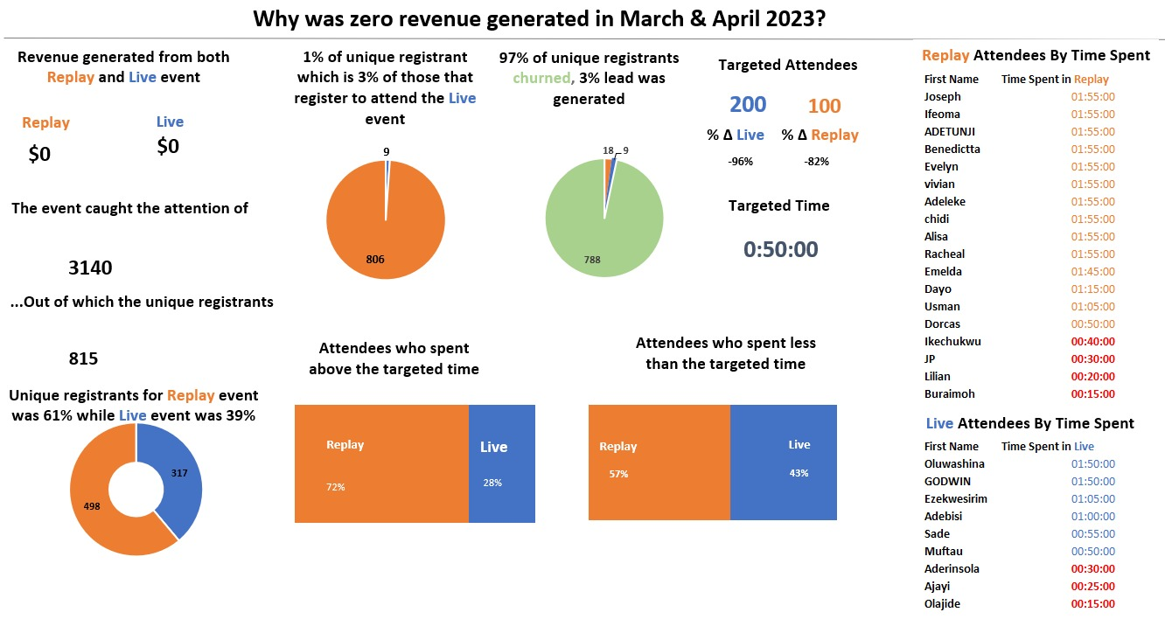

Slide 11

GAP ANALYSIS OVERVIEW
Product/Service Type
Essential for proper benchmarking.
2. No means of contact and follow-up after registration
The registrants were not sent reminder email because their email address and phone number were not collected
3. Uncertainty of the webinar content
The content of the Webinar needs to be review to know if it meet the needs and aspiration of the attendee who didn’t stay up to the targeted time.
4. User Demography
Target ads based on gender, age, region for optimized conversion growth.
5. Revenue Generation Clarity
Determine digital integration or offline collection to assess revenue concerns

Slide 12
RECOMMENDATIONS
Address Data Gaps
Immediate resolution for critical analysis and accurate forecasting.
Implement Feedback Systems
Introduce questionnaires, surveys, and feedback reviews for better webinar experience.
Contact Detail
Contact details should be included in the registration form, so registrants can be reminded to attend the webinar that they signed up for.
Registrants Demography
User demographic information are needed to be able to target the appropriate audience for optimal conversion
Integration of Marketing strategy
A wholistic marketing strategy should be adopted which will focus on all the processes to selling a product/services

Slide 13

CONCLUSION
Although the webinar had a high rate of unique registration, yet 97% of registrants churned, which is a sign of ineffective marketing strategy.
To effectively resolve this, bridging the identified gaps with precise data is essential for in-depth analysis and problem resolution

Slide 14


Slide 15

QUESTIONS?

